Slide 1
Northwind Sales Analytics
Exploratory Data Analysis and Business Intelligence
By: Tarun Singhal
Role: Data Analytics Project
Tools Used: Excel, Power BI
Date: 12th March 2026

Slide 2
Project Overview
This project analyzes a multi-table retail dataset to uncover insights related to customer behavior, product demand, sales performance, and supplier operations.
The analysis was performed using Excel and Power BI, applying techniques such as:
Exploratory Data Analysis (EDA)
Data modeling
Pivot analysis
Statistical analysis
Interactive dashboard creation

Slide 3
Project Objective
Understand customer purchasing behavior and segmentation.
Identify top-performing products and categories.
Analyze order trends and seasonal demand patterns.
Evaluate supplier distribution and pricing patterns.
Monitor employee and shipping performance.
Build interactive dashboards to support data-driven decisions.

Slide 4
Data Dictionary
Suppliers
Columns | Data Type | Description
SupplierID | Number | Unique identifier for suppliers table
CompanyName | Text | Name of the company
ContactName | Text | Name of the contact person
ContactTitle | Text | Position of the contact person
Address | Text | Address of the supplier
City | Text | City of the supplier
Region | Text | Region of the supplier
PostalCode | Text | Postal code of the supplier
Country | Text | Country of the supplier
Phone | Text | Phone of the supplier
Fax | Text | Fax of the supplier
Products Supplied | Number | Custom column -> Total number of products supplied by the supplier
This table stores information about the company's suppliers.
It includes fields for supplier ID, company name, contact name, contact title, address, city, region, postal code, country, phone, fax, and home page.

Slide 5
Data Dictionary
Shippers
Columns | Data Type | Description
ShipperID | Number | Unique identifier for shippers table
CompanyName | Text | Name of the shipping company
Phone | Text | Phone of the shipper
Orders Shipped | Number | Custom Column -> Total number of products shipped by the shipper
Total Freight | Currency | Custom Column -> Total freight charged by the shipper
This table stores information about the company's shipping companies.
It includes fields for shipper ID, company name, and phone.

Slide 6
Data Dictionary
Products
Columns | Data Type | Description
ProductID | Number | Unique identifier for Products table
ProductName | Text | Name of the product
SupplierID | Number | Reference to the SupplierID in Suppliers Table
CategoryID | Number | Reference to the CategoryID in Categories Table
QuantityPerUnit | Text | Quantity in the single unit
UnitPrice | Number | Marked Price per unit
UnitsInStock | Number | Number of units in stock
UnitsOnOrder | Number | Number of units ordered in total
ReorderLevel | Number | Inventory quantity that triggers a new order to suppliers - (Average Daily Usage × Lead Time) + Safety Stock
Discontinued | Number | 0/1 - Whether the product is discontinued or not
Total Orders | Number | Custom Column -> Total orders of the products placed
Total Quantity Sold | Number | Custom Column -> Total quantity of the products sold
Total Cost | Currency | Custom Column -> Total cost of the product
Total Sales | Currency | Custom Column -> Total sales of the product
Gross Profit per unit | Currency | Custom Column -> (Revenue - Sales) for each unit
Total Gross Profit | Currency | Custom Column -> Total gross profit for each product
Product Status | Text | Custom Column -> Whether the product is ongoing or discontinued
This table stores information about the company's products.
It includes fields for product ID, product name, supplier ID, category ID, quantity per unit, unit price, units in stock, units on order, reorder level, and whether the product is discontinued.
Note: UnitPrice Column is the Marked Price column.

Slide 7
Data Dictionary
Orders
Columns | Data Type | Description
OrderID | Number | Unique identifier for Orders table
CustomerID | Text | Reference to the CustomerID in Customers Table
EmployeeID | Number | Reference to the EmployeeID in Employees Table
OrderDate | Date | Date of the order
RequiredDate | Date | Date till which the product is required
ShippedDate | Date | Date of the product shipping
ShipVia | Number | Reference to the ShipperID in Shippers Table
Freight | Currency | Freight charged for the product
ShipName | Text | Name of the ship
ShipAddress | Text | Address of shipment
ShipCity | Text | City of shipment
ShipRegion | Text | Region of shipment
ShipPostalCode | Text | Code of shipment
ShipCountry | Text | Country of shipment
Revenue | Currency | Custom Column -> Marked_price * Quantity * (1-discount)
Total Gross Profit | Currency | Custom Column -> [[Marked_price * (1-discount)] - Cost_price] * quantity
Net Profit | Currency | Custom Column -> Total Gross profit - Freight_charges
This table stores information about the company's orders.
It includes fields for order ID, customer ID, employee ID, order date, required date, shipped date, ship via, freight, ship name, ship address, ship city, ship region, ship postal code, and ship country.

Slide 8
Data Dictionary
Order Details
Columns | Data Type | Description
OrderID | Number | Reference to the OrderID in Orders Table
ProductID | Number | Reference to the ProductID in Products Table
UnitPrice | Currency | Cost Price per Unit of the product
Quantity | Number | Quantity of the product ordered
Discount | Number | Discount on the product amount
Total Cost amount | Currency | Custom Column -> Total cost amount of the product
Order Date | Date | Custom Column -> Order date from orders table
UnitPrice (Marked Price) | Currency | Custom Column -> Marked price from products table
Total revenue | Currency | Custom Column -> Marked_price * Quantity * (1-discount)
Gross Profit | Currency | Custom Column -> [[Marked_price * (1-discount)] - Cost_price] * quantity
Category | Text | Custom Column -> Category from categories table
Category Name | Text | Custom Column -> Category name from categories table
This table stores detailed information about the items within each order.
It includes fields for order ID, product ID, unit price, quantity, and discount.
Note: UnitPrice Column is the Cost Price column.

Slide 9
Data Dictionary
Employees
Columns | Data Type | Description
EmployeeID | Number | Unique identifier for Employees table
FirstName | Text | First Name of the employee
LastName | Text | Last Name of the employee
Title | Text | Position in the organisation
TitleOfCourtesy | Text | Title Of Courtesy of the employee
BirthDate | Date | Birth Date of the employee
HireDate | Date | Hire Date of the employee
Address | Text | Address of the employee
City | Text | City of the employee
Region | Text | Region of the employee
PostalCode | Text | Postal Code of the employee
Country | Text | Country of the employee
HomePhone | Text | Home Phone of the employee
Extension | Number | Position in the organisation
Photo | General | Photo of the employee
Notes | Text | Brief information about the employee
ReportsTo | Number | EmployeeID to which current employee reports to. -1 indicates the employee reports to no one
Total Orders | Number | Custom Column -> Total orders brought by the employee
Total sales | Currency | Custom Column -> Total sales made by the employee
Average sale per order | Currency | Custom Column -> Average sale per order made by the employee
This table stores information about the company's employees.
It includes fields for employee ID, last name, first name, title, title of courtesy, birth date, hire date, address, city, region, postal code, country, home phone, extension, photo, notes, reports to, and photo path.

Slide 10
Data Dictionary
Customers
Columns | Data Type | Description
CustomerID | Number | Unique identifier for Customers table
CompanyName | Text | Name of the customer company
ContactName | Text | Name of the contact person in the company
ContactTitle | Text | Position of the contact person in the company
Address | Text | Address of the customer
City | Text | City of the Customer
Region | Text | Region of the customer
PostalCode | Text | Postal Code of the customer
Country | Text | Country of the customer
Phone | Text | Phone of the customer
Fax | Text | Fax of the customer
Total Orders | Number | Custom Column -> Total orders placed by the customer
Average Order Amount | Currency | Custom Column -> Average order amount of the orders placed by the customer
Total Amount Spent | Currency | Custom Column -> Total amount spent by the customer
This table stores information about the company's customers.
It includes fields for customer ID, company name, contact name, contact title, address, city, region, postal code, country, phone, and fax.

Slide 11
Data Dictionary
Categories
Columns | Data Type | Description
CategoryID | Number | Unique identifier for Categories table
CategoryName | Text | Name of the category
Description | Text | Description of the category
Picture | General | Picture of the category
Total Products | Number | Custom Column -> Total number of products in the category
Total cost | Currency | Custom Column -> Total cost of products in each category
This table stores information about the product categories.
It includes fields for category ID, category name, and description.

Slide 12
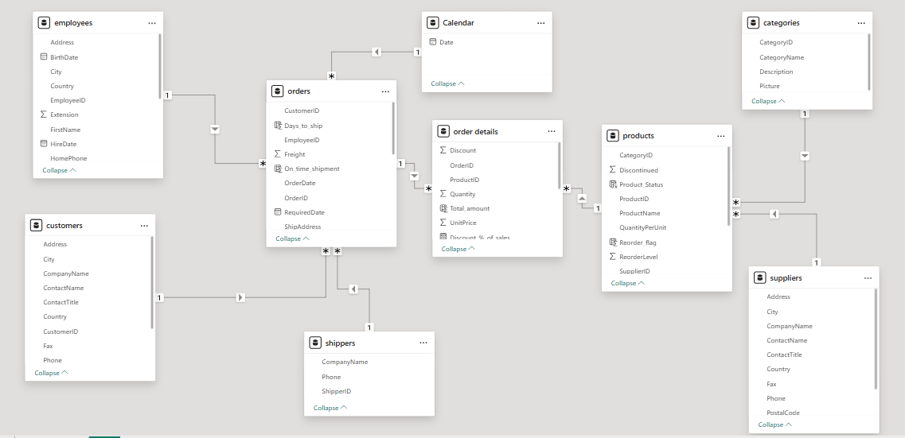
ER diagram

Slide 13
Problem Statement 1
Customer ID | Total orders | Total Revenue
SAVEA | 31 | $ 1,08,703.29
RATTC | 18 | $ 57,317.50
QUICK | 28 | $ 1,14,693.87
MEREP | 13 | $ 32,827.90
KOENE | 14 | $ 32,040.65
HUNGO | 19 | $ 52,623.64
HANAR | 14 | $ 33,591.61
FRANK | 15 | $ 29,477.64
FOLKO | 19 | $ 30,345.03
ERNSH | 30 | $ 1,11,362.43
Grand Total | 201 | $ 6,02,983.56
Which customers contribute the most revenue and how frequently do they place orders?
Insights
Average orders per customer ≈ 9
A small group of customers generates significant revenue share.
Indicates strong repeat purchase behavior.

Slide 14
Problem Statement 2
Category | Total revenue
Beverages | $2,88,694.65
Dairy Products | $2,51,147.60
Confections | $1,79,863.65
Meat/Poultry | $1,74,622.55
Seafood | $1,37,989.31
Condiments | $1,13,992.56
Produce | $1,05,745.71
Grains/Cereals | $1,01,646.94
Grand Total | $13,53,702.97
Which products and categories contribute the most to revenue?
Insights
Beverages emerged as the highest revenue category.
A few top-selling products dominate sales volume.
These products should receive inventory and promotion priority.

Slide 15
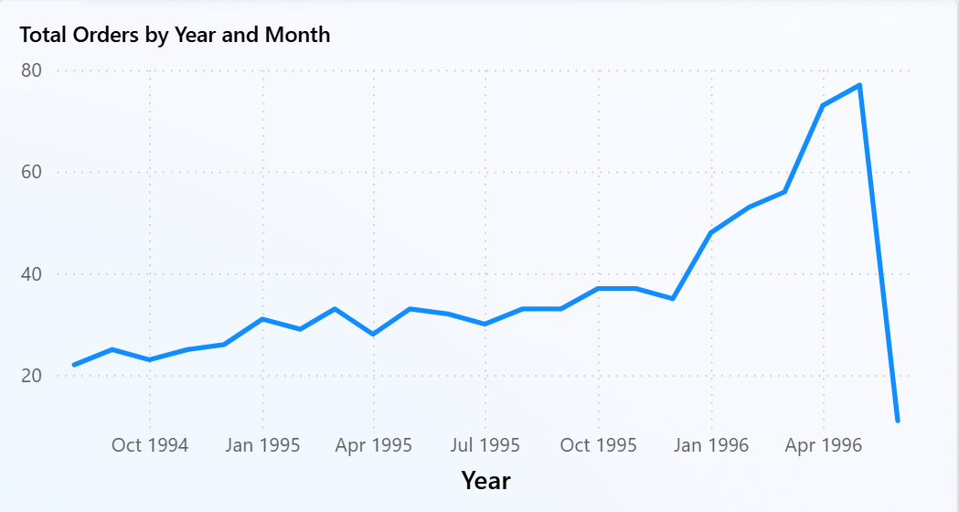
Problem Statement 3
How does product demand vary over time?
Insights
Sales show seasonal demand patterns.
Certain months have significantly higher order volumes.
Helps with inventory planning and forecasting.

Slide 16
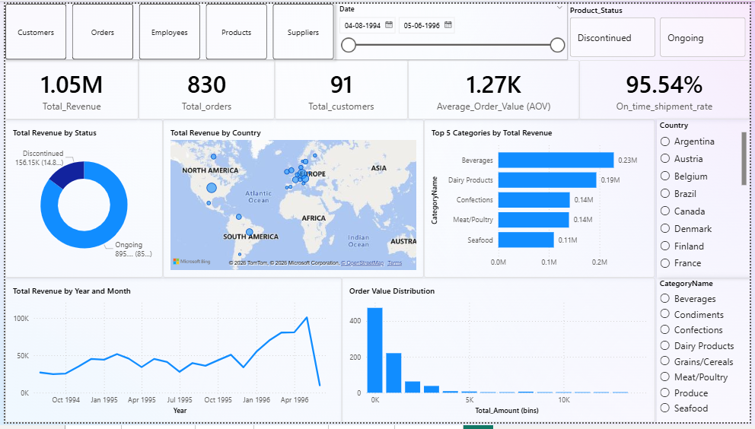
Power BI Dashboard

Slide 17
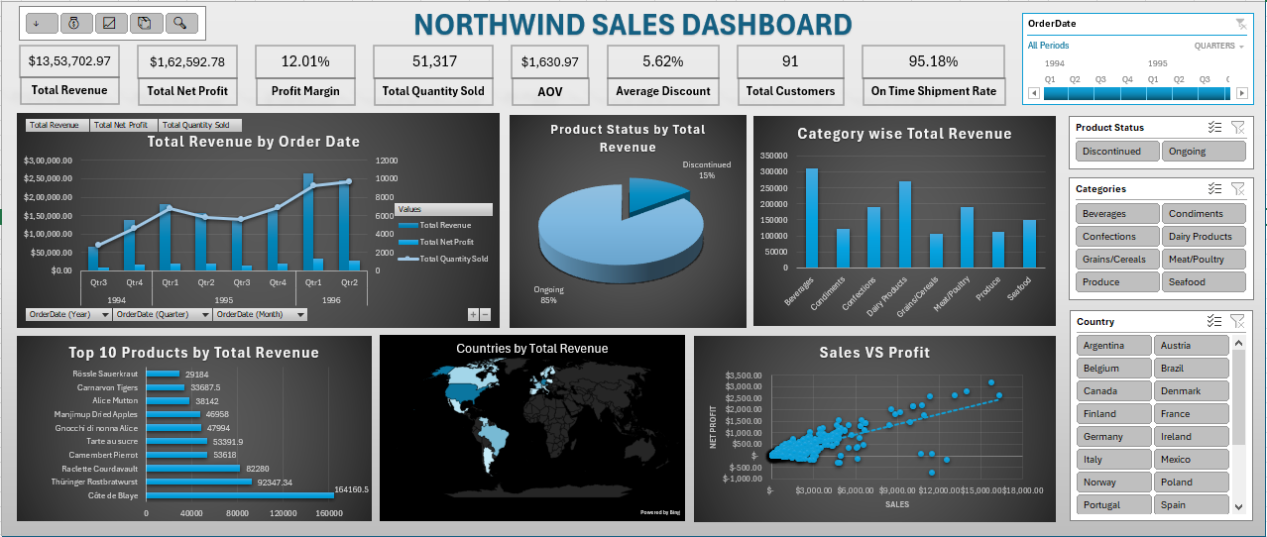
Excel Dashboard

Slide 18
Key Insights
Revenue is concentrated among a small group of repeat customers.
Beverages is the highest revenue-generating category.
Product demand shows seasonal fluctuations.
Some suppliers dominate multiple product categories, indicating dependency risk.
Price and stock levels show weak correlation with sales, suggesting demand depends more on product type.

Slide 19
Conclusion
This project demonstrates how data analytics and business intelligence tools can uncover meaningful insights from operational data.
Through EDA, statistical analysis, and dashboard development, the project identified:
Customer purchasing patterns
Revenue-driving products
Seasonal demand trends

